Slide 1
HS 200: Environmental Studies
Tribal Ecology, State and Development in India
Raile R. Ziipao, Ph.D
Assistant Professor of Sociology
Department of Humanities and Social Sciences
Indian Institute of Technology, Bombay
ziipao@hss.iitb.ac.in
1

Slide 2
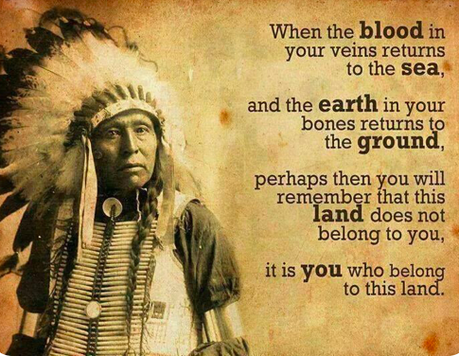
Source: Native American
1

Slide 3
Who are tribes in India?
What is their relation with nature and their ecology?
Do tribes have intrinsic relation with nature?
Are tribal systems of governance, tradition, and customary laws hurdles for development and combating climate change in India or vis-versa ?
What happens when state and other agencies appropriate tribal ‘Jal, Jangal and Jameen’?
Why do tribal protests on mega infrastructure development projects located in their territory?

Slide 4
Conceptualizing Tribes
  Colonial/evolutionary perspective: tribes as diffident forest dwellers, savages, primitive, half naked uncivilized, backward. Viewed tribes as incapable of producing or partaking in knowledge production.
  Caste perspective: Tribes as backward Hindus (G.S. Ghurye); tribes are seen as caste-like entities or in other words caste-centric perspective of tribal studies e.g. tribes transformation into castes.
  Perspective from within: Tribes as a society with a definite area/territoriality, language, cultural homogeneity and unifying social organization (Xaxa, 2008). Or tribes as non-caste society.
  Traits ascribe to tribal societies:
    Relative egalitarianism within the group, the absence of complex political structures, strong and functional kinship bonds, cooperation, territorial integrity, cultural and linguistic distinctiveness, and intrinsic relation with nature (ibid.).

Slide 5
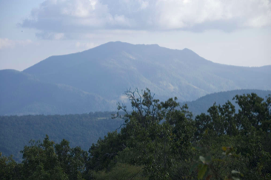
What is the relationship between tribals and their environment?
  The culture of a community is shaped by the environment on the one
  hand and on the other hand, human beings too have an impact on the
  environment.
  Rapid advances and drive for economic growth have been at the cost of
  natural resources.
  Techniques based on traditional knowledge systems are being sought as
  development alternative intervention for sustainable development.
  Tribal ways of dealing with nature can be seen as one alternative to
  climate change and environmental destruction.
The relationship of tribes with nature can be explored in two ways:-
  The way in which nature and the environment are articulated and represented in riddles, stories, myths, legends, feast, and festivals (cultural domain)
  The ways in which the tribes relate with nature and the environment in their day-to-day existence, i.e. the existential conditions of their living.
Many tribes in India still live primarily off the land and forest (Xaxa 2008).

Slide 6
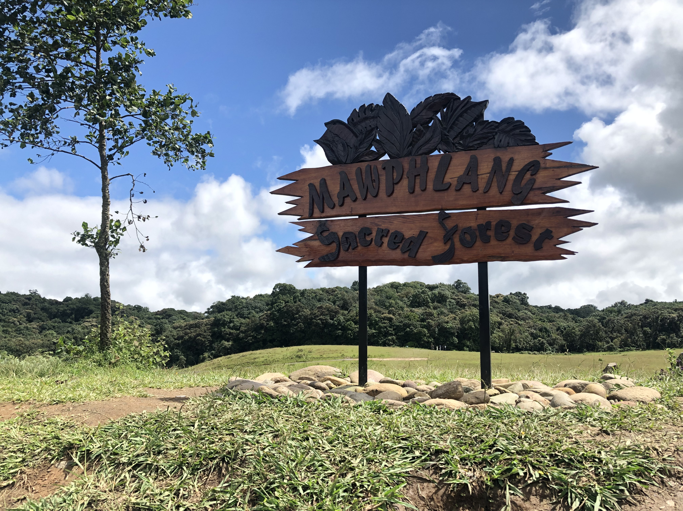
Tribals dependence on the natural environment is both subsistence-
based and cultural, conservation practices among them indicate an
obligation towards the environment which is carried out in many
ways.
The most respected and conserved is what is known as the sacred
grove.
  A sacred grove is often a dense cluster of trees that is considered to be the abode
  of the guardian spirit of the villages. Such attitudes and world views of tribes help to maintain and
  conserve the natural environment (Xaxa 2008).
The harmony between the natural and the social worlds that the tribes had maintained for centuries was ruptured during the colonial period. This had much to do with the forest policy of the colonial state (ibid.).
In post-colonial development, nature represents a terrain of politicization by which tribal communities contest state developmentalism, extractive economies, and military-paramilitary violence.
Source: rrziipao

Slide 7
Tribal Ecologies
We have a sacred responsibility to care for the land. The land belongs to me, and I belong to the land, I am the land, and the land is me, we are inseparable
-Tuisem Ngakang
Land is the ontological core of a tribe’s ̳being and fullness (Bodhi and Ziipao 2019).
  Land constitute the bedrock of tribal identity.
  Tribes tend to treat their non-human surroundings, especially their land, water and forest as a living entities and mostly as part of their being or sometimes as an extension of themselves (ibid.)
Territory is generally holistic and constitutes hills, rivers, natural and mineral resources, air, waters and peoples who firstly inhabit it.
Humans as an interconnected web of relationship with all living and non-living beings and recognizes that their survival depends on how they interact with each other and everything around them (Thaikho 2019).

Slide 8
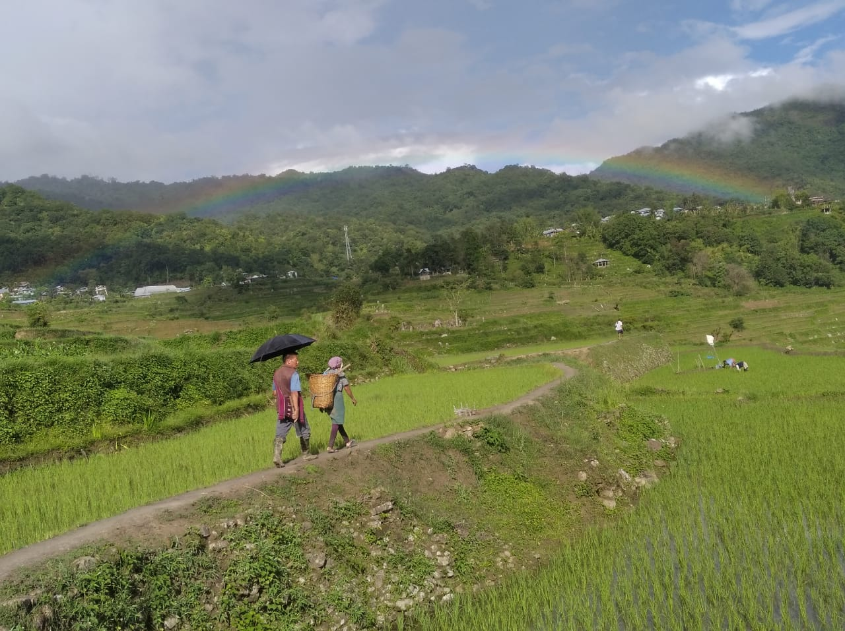
  Land is not a mere commodity but conceived as being alive
  For tribes, the land is sacred in itself and their identity,
  culture, and traditions stem from it (Bodhi and Ziipao 2019).
  ‘The land is more than a habitat or political boundary.
  The land and local environment, particularly the forests,
  are the basis of the Nagas’ social, cultural and economic
  system (Shimray 2012, 54).
  Tribals have an intrinsic symbiotic connection between
  their identity, land, territoriality and nature.
  Beliefs, rituals, culture, etc. are all linked to tribal perception of nature.
  What people do about their ecology depends on what they think about themselves in relation to things around them (Lynn 1967).
Source: rrziipao

Slide 9

Double Decker Living Root Bridge in Meghalaya
Photo Courtesy:
Monica Humphries

Slide 10
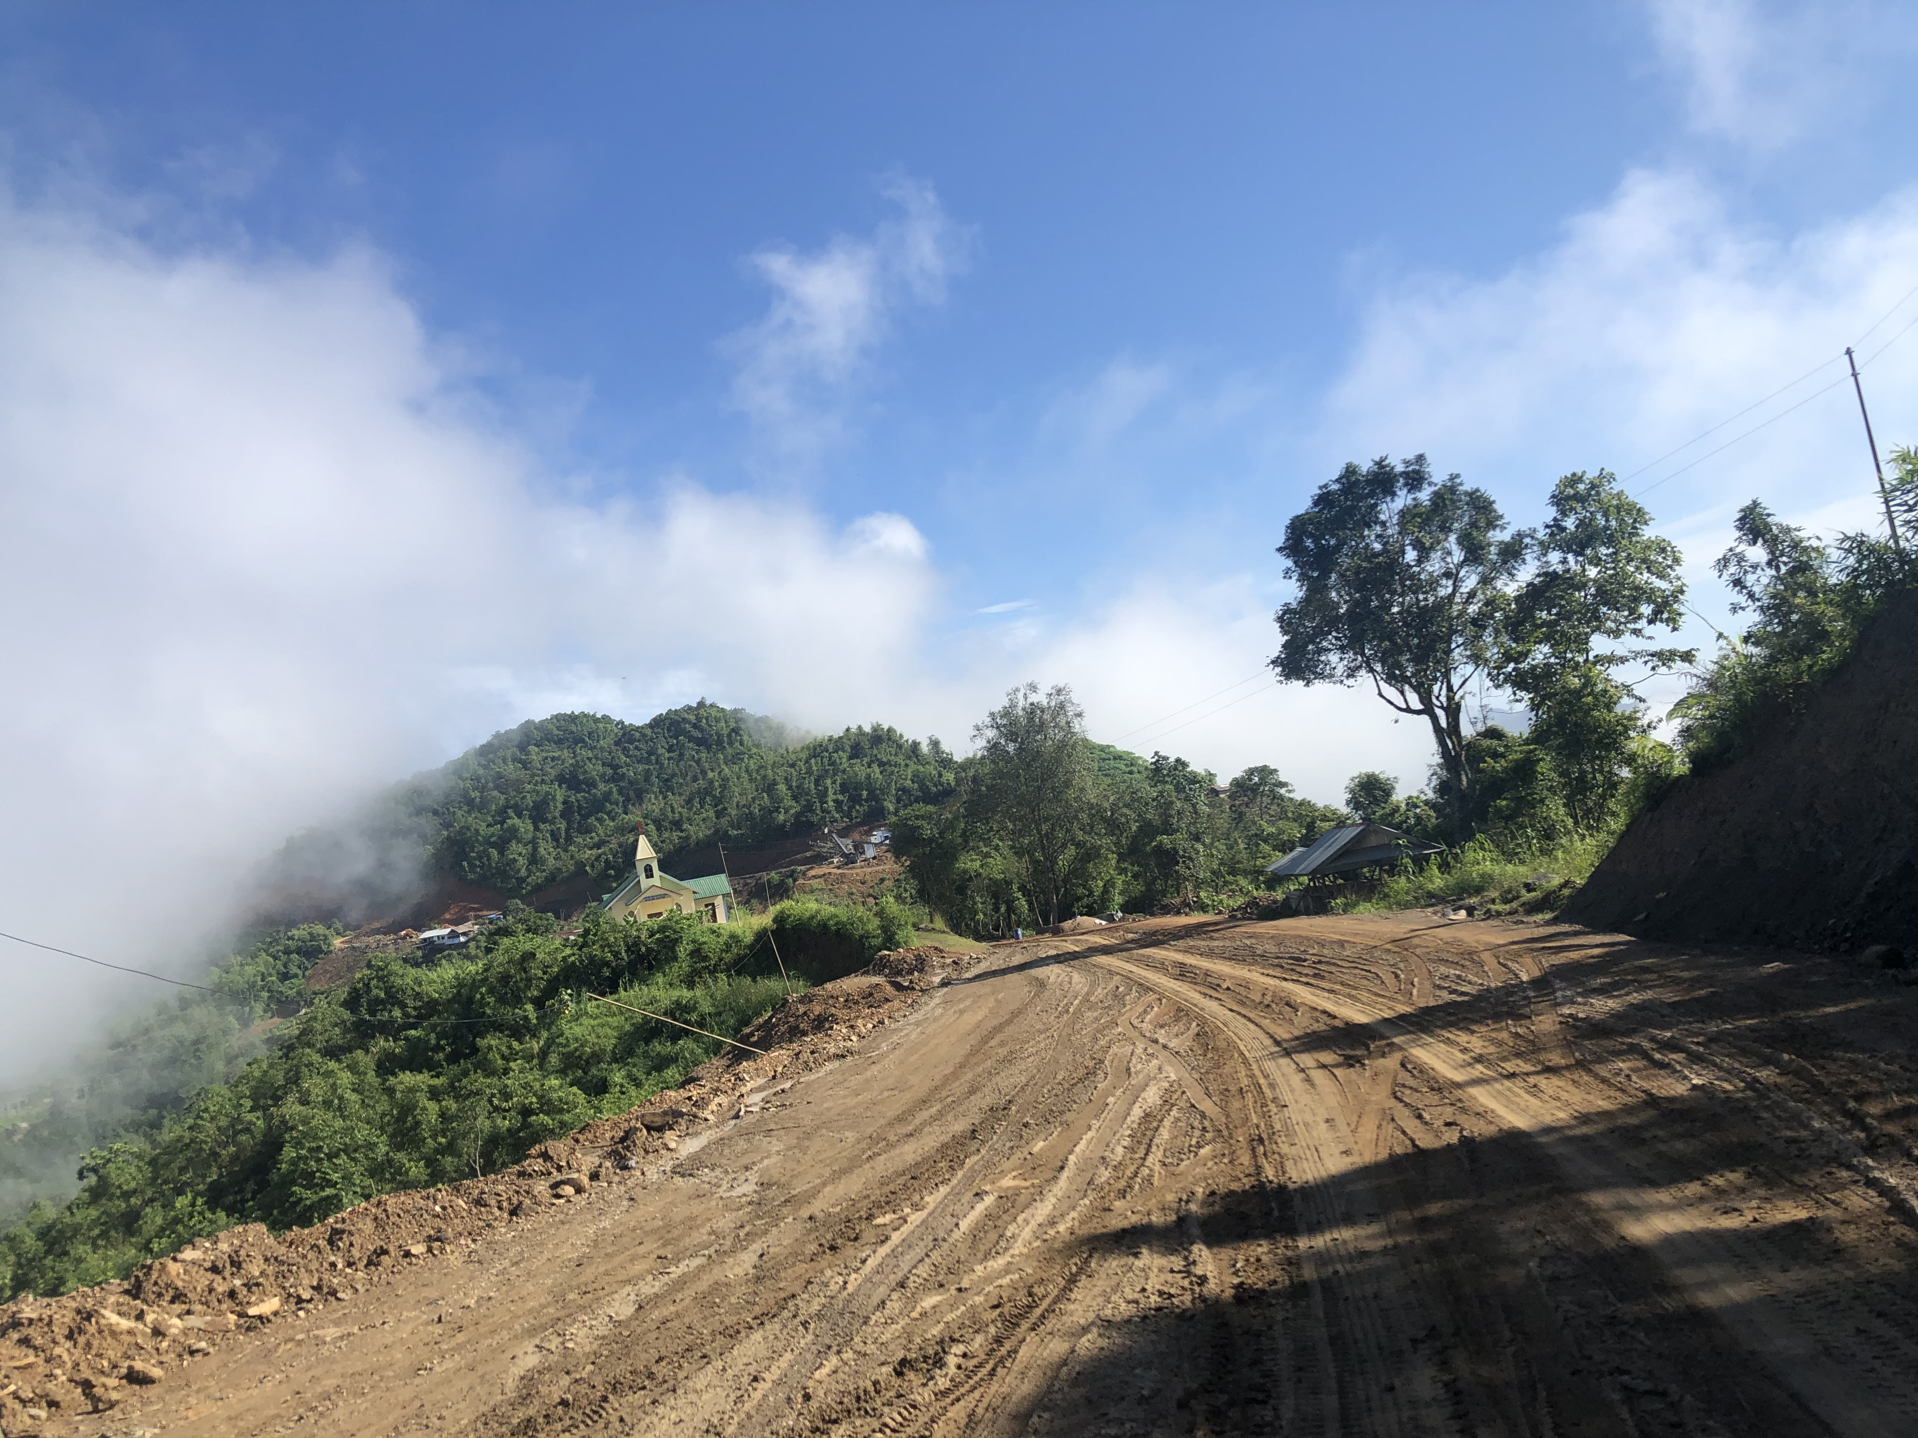
Photo: ziipao
Infrastructuring Development and Ecology in Tribal areas
  The aggressive push for mega infrastructure development in tribal areas have adverse environmental consequences.
  Securitization of development and the question of development with justice.
  In the contemporaneous development practices and approach of the state, tribal knowledge systems, traditional institutions, and their ecology take a backseat.
.
Tribals continue to be treated as mere recipients of the so-called modern knowledge and beneficiaries of welfare measures only rather than as part of the knowledge ecosystem.
    This approach to development is antithesis to tribal epistemology and amounts to epistemicide.

Slide 11
We will not leave our village nor our land

